Slide 1

Project Report of “Weather App”
Takahiro
Subject:
Software Development Technology
2022.11.28.
DQ4WX0 Takahiro Fujiwara
EQK6P6 Yasmine Trabelsi
Notes:
We would like to introduce our project, Weather app.
At first, we were 4 members but other 2 are dropped
Because they wanted to do other work.
Therefore, we had to finish it in 10 working days.

Slide 2
Introduction
Takahiro
Developed Weather App
Shows weather of specified city
Feature
Just show the current weather
Using Weather sever
Non-functional requirements
Packaging / deployment work is not included in this project
Multiple Platform
Windows UWP / Android / iOS
Develop by MS Visual Studio 2022.
Communication Diagram for Weather App
1: Specify a city
User
Specify a city and Display Weather
4: Display Weather with value conversion
2: Generate API String
Result
Weather Interface
3: Post API as HTTPS
Result with JSON format
Weather Server via internet
Notes:
So, this is the introduction.
We developed weather application,
Feature is,
You can easy to understand, it shows weather of specified city.
Using Weather sever on the internet.
We defined the nun-functional requirements
That is
Packing and deployment work is not included in this project.
However, we tested on multiple platform,
Windows, Android, iOS
Using Visual Studio 2022.
Right side is a UML Communication Diagram for out App.
Just …

Slide 3
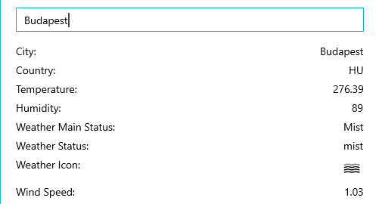
Application Image and Our Challenges
Takahiro
There are reference program
Just get data and display it
We will do:
Create a button to show the city
Change Temperature unit to Celsius °C
Add units for Humidity, Wind,
Add weather image picture
TDD approach for API interface
Unknown value comes from API
Application Image
SHOW
Weather Image Picture
Notes:
This is an application image for our app.
There are some referenced program on the internet,
however, these are just getting data and display it.
We plan to do more but we did:
- Add a button to show a city
- Temperature conversion to Celsius degree.
- Add units for humidity and wind speed,
- Add weather image picture to the bottom
- and, TDD approach for API interface – we will introduce this later

Slide 4

Technologies
Takahiro
OpenWeatherMap
An online service
Owned by OpenWeather Ltd
Provides
Global weather data via web API
Including current weather, forecasts, historical weather data
Some functions are free
Technology | Purpose
Xamarin.Forms | Make available on Windows/Android/iOS.
MVVM model | Separate development with some developers.
Weather API | Get the current weather for each city in the world
Nuget Packages
Microsoft. Bcl.Build | Provides build infrastructure components so that projects referencing specific Microsoft packages can successfully build.
Microsoft. Net.Http | HttpClient for sending requests over HTTP, for processing HTTP messages.
Newtonsoft.Json | Handle JSON data easily
Notes:
These are the technologies we used.
The fist one, weather information, we used OpenWearMap
this is an online server and it looked good.
They provide Global weather data via web API
it is including current weather, forecasts, historical weather data.
And some functions are free to use.
On right side,
We use Xamarin forms,
MVVM model,
Weather API,
Nuget pages for Microsoft.BCL. Build,
HTTP client library
And JSON handling library.

Slide 5
Development Env. And Schedule
Takahiro
Development Environment
Schedule
Development Environment
OS | Windows 10 Home 22H2
Visual Studio | Visual Studio Community 2022 (64bit) Version 17.4.1
Programming Language | C#, XAML
Test Environment | Android Emulator Android 9.0 (Pixel 3a)
 | iOS Simulator on macOS
Task Working Day➔ | 1 | 2 | 3 | 4 | 5 | 6 | 7 | 8 | 9
Research | X | X
Original Implement |  | X
Feature: Making button |  |  | X | X
Feature: Temperature |  |  |  |  | X
Feature: Add unit |  |  |  |  | X
Feature: Add Image |  |  |  |  |  | X | X
Final Test |  |  |  |  |  |  |  | X
Documentation |  | X | X |  | X |  | X |  | X
Notes:
On this page,
Left side shows our development environment
Right side is our schedule.
Documentation schedule is added to some part
to don’t forget the issues.

Slide 6
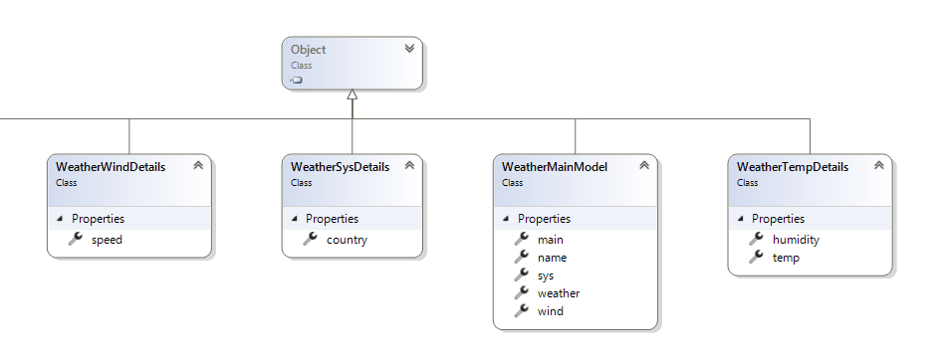
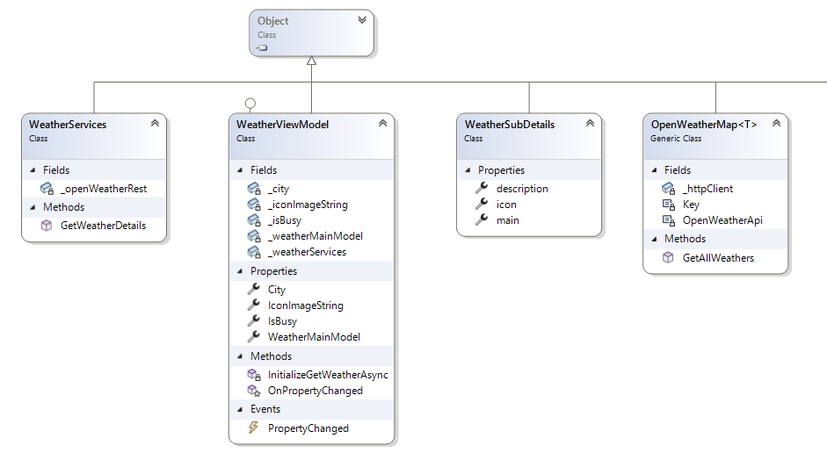
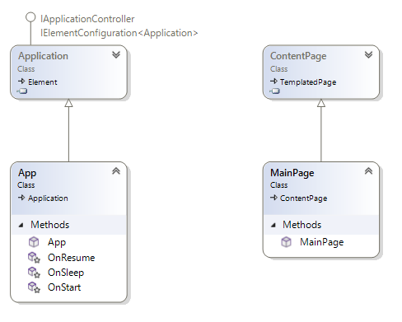
Development
Takahiro
Class Diagram and its purpose
Parse weather speed from JSON data
Parse country from JSON data
Parse weather icon from JSON data
Parse temperature, humidity
Get weather data from a server (async)
Main of the model. It has all classes
OpenWeaterMap API
Generate and post weather API, set large picture
Smartphone system event
Page view
Notes:
This figure shows UML Class diagram
Blue text are added for easy understanding the purpose.

Slide 7
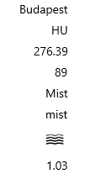
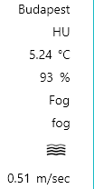
In Our Actual Work
Takahiro
Android App shows white screen
UWP is succeeded
We can think a few reason
Emulator problem, logic, API
We doubted the web API
API introduces as http://
But recently http:// is refused by many web browser
Degree Celsius conversion
Formula: Celsius = Kelvin – 273.15
We found, able to set unit to the API string
https://api.openweathermap.org/data/2.5/weather?q={city}&appid={key}&units=metric
Original version
Update version
Notes:
Now short tips of our work.
At first, android app is showing white screen.
But for the UWP app, it is succeeded to show the weather
We can think reason a few.
- Emulator, or logic, or API.
On the web info, there is http://
but we know recently http:// is refused by many web browser
So, we changed it then worked.
One more tip.
Degree Celsius conversion.
The web API returns the value of Kelvin for the temperature.
Formula is not difficult but we understood there is a unit parameter in the API
So, we set this red colored text to the parameter for the API

Slide 8
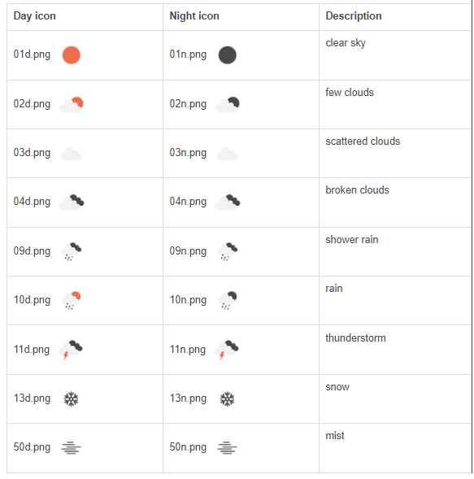
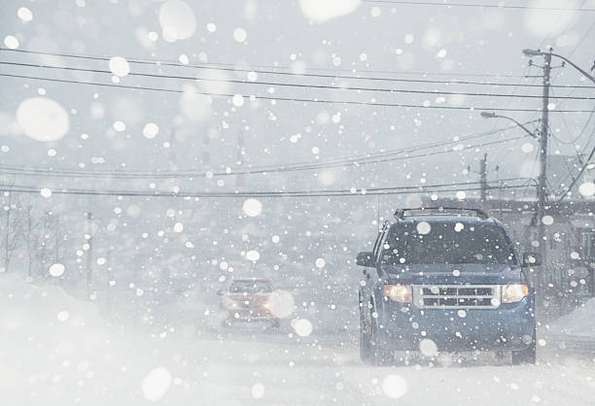

Large Picture for Every Weather
Takahiro
Find from license free pictures, iStock Photo
Day picture is used also at night – it was hard to find all kinds of photos
Notes:
And this is our solution (current solution) for the large picture at the bottom.
On the OpenWeatherMap, there are weather icon, 13 for a day and 13 for a night.
The picture we prepared ones are only for a day.
Because it was hard to find night weather picture.

Slide 9
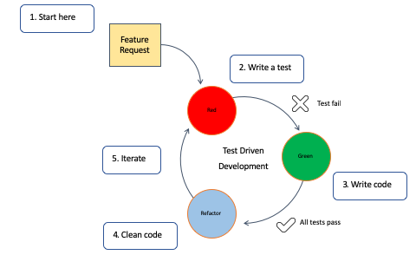
Test-Driven Development (TDD)
Yasmine
TDD: Test-driven development is a software development process relying on software requirements being converted to test cases before software is fully developed, and tracking all software development by repeatedly testing the software against all test cases.
We used TDD approach for showing picture for each weather.
There are possibility of unknown weather
Such as “Blizzard”, “Heavy rain”
ICON file name has 50 but we could have prepared only 13 icons.

Slide 10
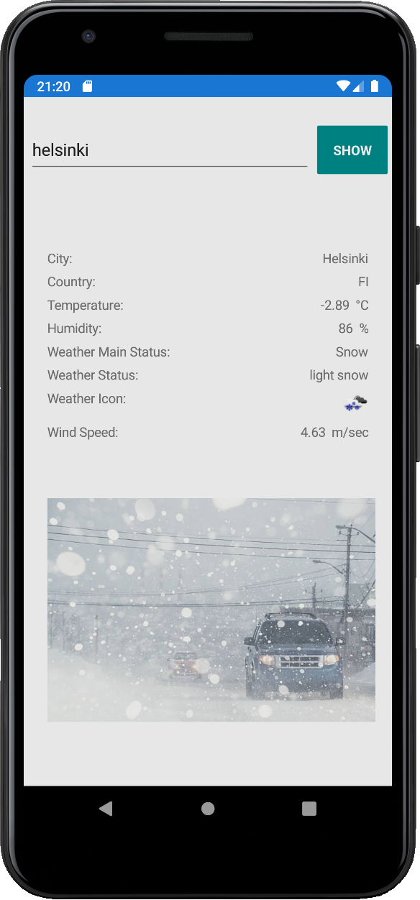
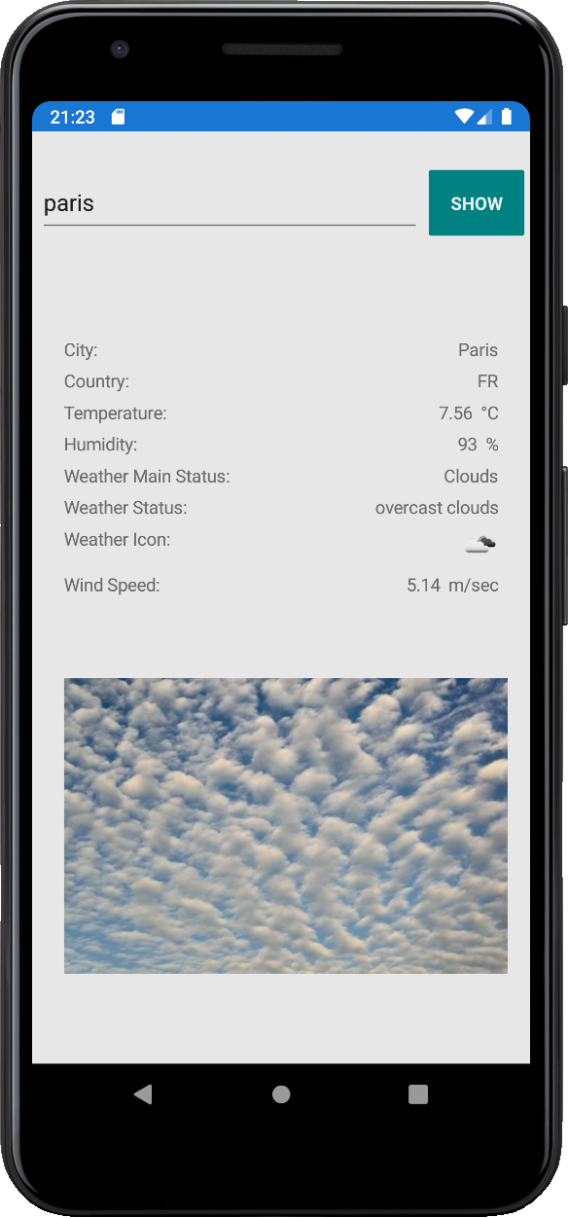
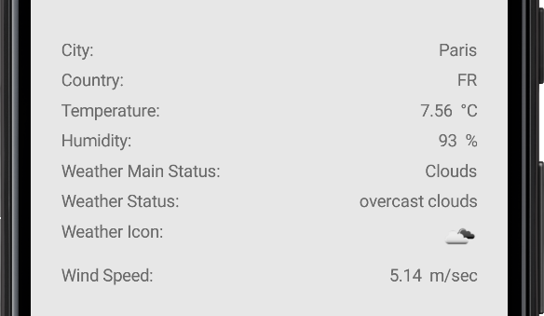
Display Results Emulator Android 9.0 Pixel 3a
Yasmine

Slide 11
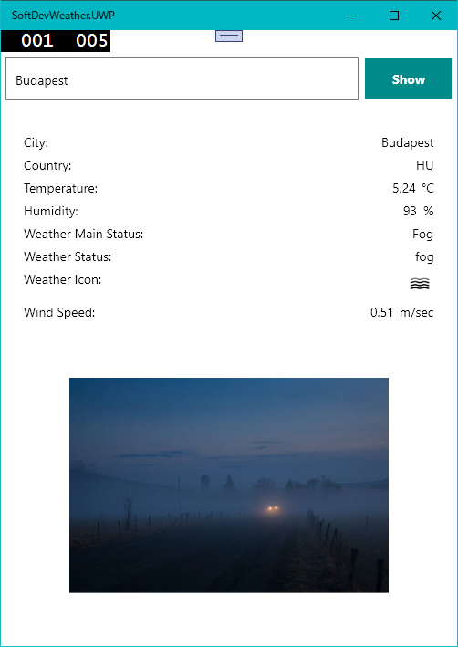
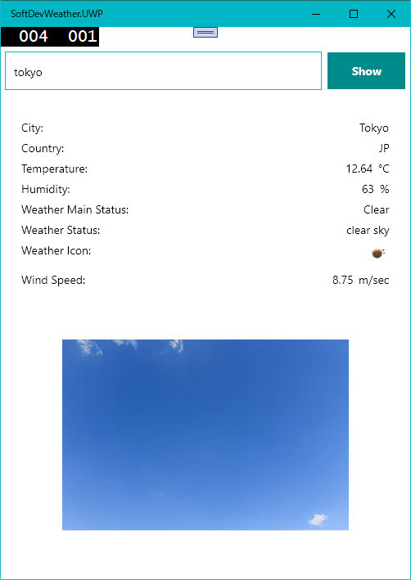
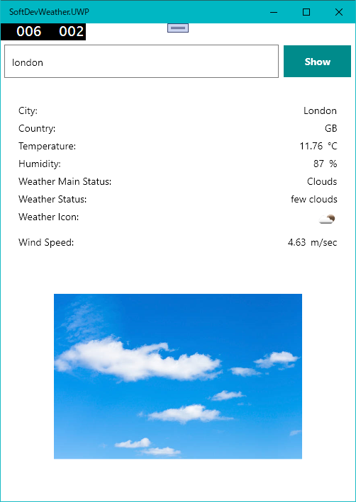
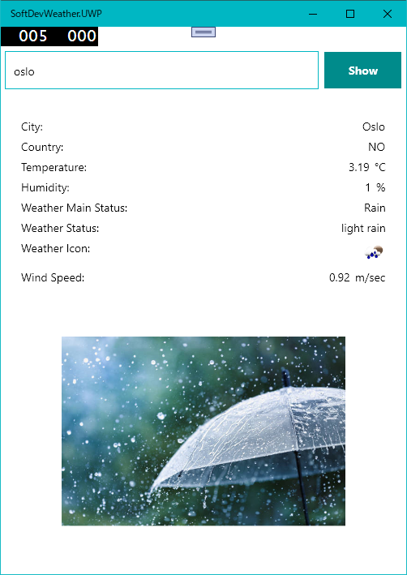
Display Results Windows UWP
Yasmine

Slide 12
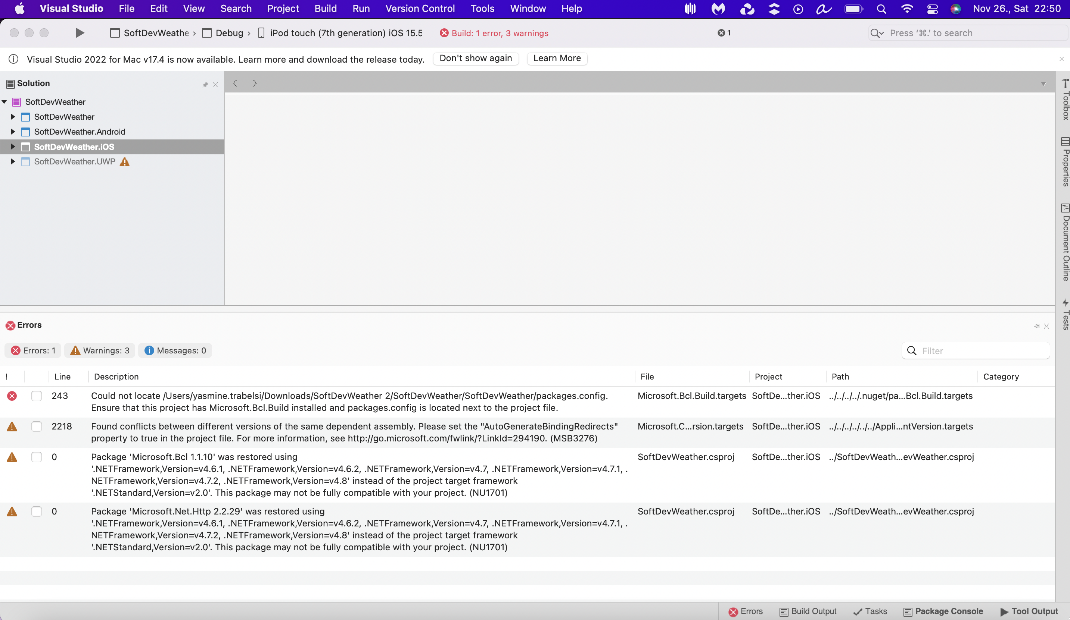
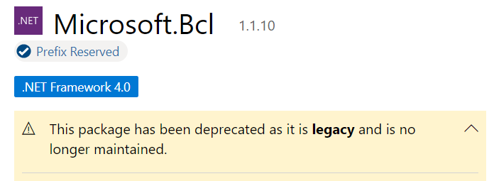
Results iOS Simulator
Yasmine
We also testes on macOS iOS Simulator
There is error and could not run it
Microsoft.Bcl is deprecated.
We could not find the solution in these working days.
/Users/yasmine.trabelsi/.nuget/packages/microsoft.bcl.build/1.0.21/build/Microsoft.Bcl.Build.targets(5,5): Error: Could not locate /Users/yasmine.trabelsi/Downloads/SoftDevWeather 2/SoftDevWeather/SoftDevWeather/packages.config. Ensure that this project has Microsoft.Bcl.Build installed and packages.config is located next to the project file. (SoftDevWeather.iOS)

Slide 13
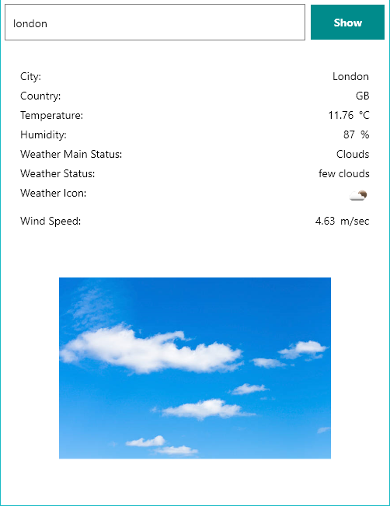
Possibilities for Further Development
Yasmine
User Interface and Design
Combo box for city history
Fit picture to the area
Weather Forecast
Now, our app shows only the current weather
There is forecast API – need to implement another JSON format
Show it as tabbed pane 

Now
Today
Tomorrow
Tuesday
Wednesday
Now

Slide 14
Experience Summary
Yasmine
Yasmine Trabelsi
Running the app on several simulators may lead to errors.
Running the app on Android emulator was successful, however running it on an iOS simulator was a fail.
First time working with Xamarin so we faced lot of challenges:
Xamarin was a new concept and even there aren’t plenty of resources on the internet about it to get more guidance.
iOS simulator is harder to understand.
On mac Still unable to download Microsoft packages in order to run apps built with a Microsoft laptop.
Takahiro Fujiwara
Preparing development environment is very hard, especially Xamarin and emulator thing.
Web information is not fit for the latest version of Xamarin and Android emulator
So, it was very hard to solve it.
However, we understood
When we got that environment, we can develop a cross platform applications, easily.
It was new to me that using Web API and JSON handlings.
Working days are not enough
Especially this semester was hard due to the Autumn holiday is disappeared – all subjects are compressed.

Slide 15
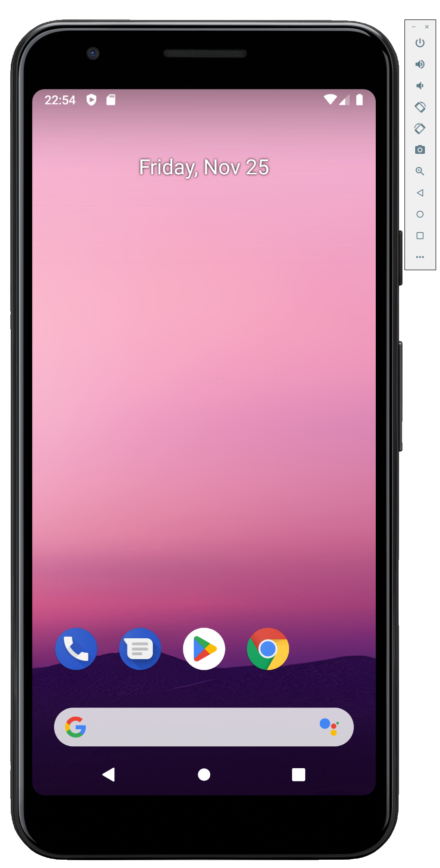
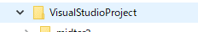
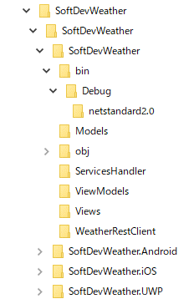
Appendix – Note for Making Environment
Yasmine
Xamarin.Forms Development Directory
Do not use longer folder name
– Easy to come to limit of max of file name
Do not use virtual drive
– Unknown restriction at runtime
Android Emulator
Use Android 9.0
On the Visual Studio 2022, we can not run the emulator with the version Android 10 or later
C:\ ⬅ Create under the root
Visual Studio creates these 3-layer folder for enabling multiplatform

Slide 16
Thanks For Your Attention
Yasmine
DQ4WX0 Takahiro Fujiwara
EQK6P6 Yasmine Trabelsi

